Slide 1
Feasibility Study
Main aim of feasibility study:determine whether developing the product
  financially worthwhile
  technically feasible.
First roughly understand what the customer wants:
  different data which would be input to the system,
  processing needed on these data,
  output data to be produced by the system,
  various constraints on the behavior of the system.

Slide 2
Activities during Feasibility Study
Work out an overall understanding of the problem.
Formulate different solution strategies.
Examine alternate solution strategies in terms of:
    resources required,
    cost of development, and
    development time.

Slide 3
Feasibility Study
In software engineering, the feasibility study is a project done to determine software’s technical and commercial viability before its development. The project evaluates the system’s impact, functionality, and performance before investing in its development.

Slide 4
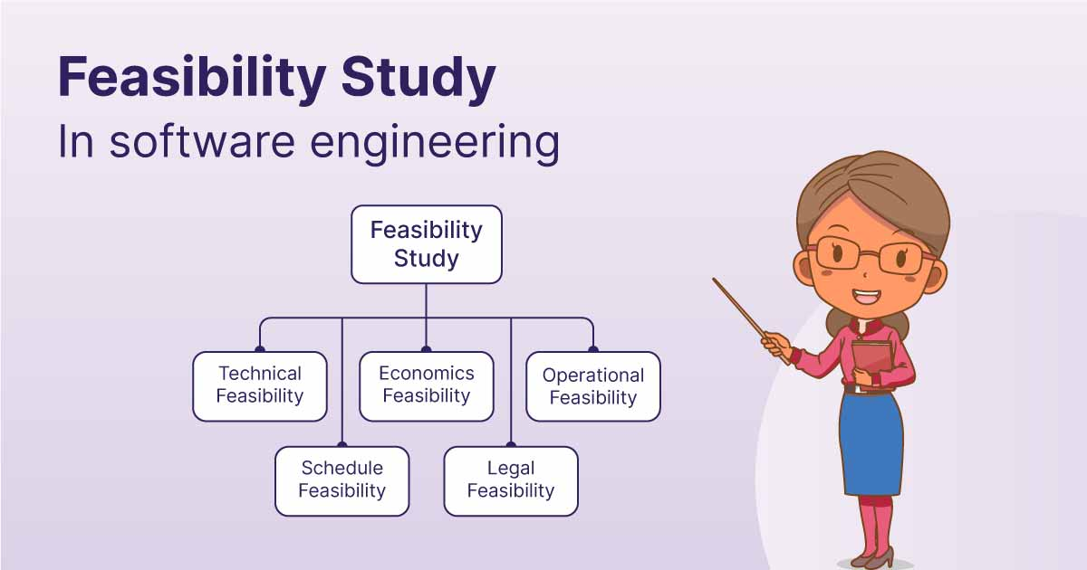
Feasibility Study

Slide 5
Activities during Feasibility Study
Perform a cost/benefit analysis:
  to determine which solution is the best.
  you may determine that none of the solutions is feasible due to:
    high cost,
    resource constraints,
    technical reasons.

Slide 6
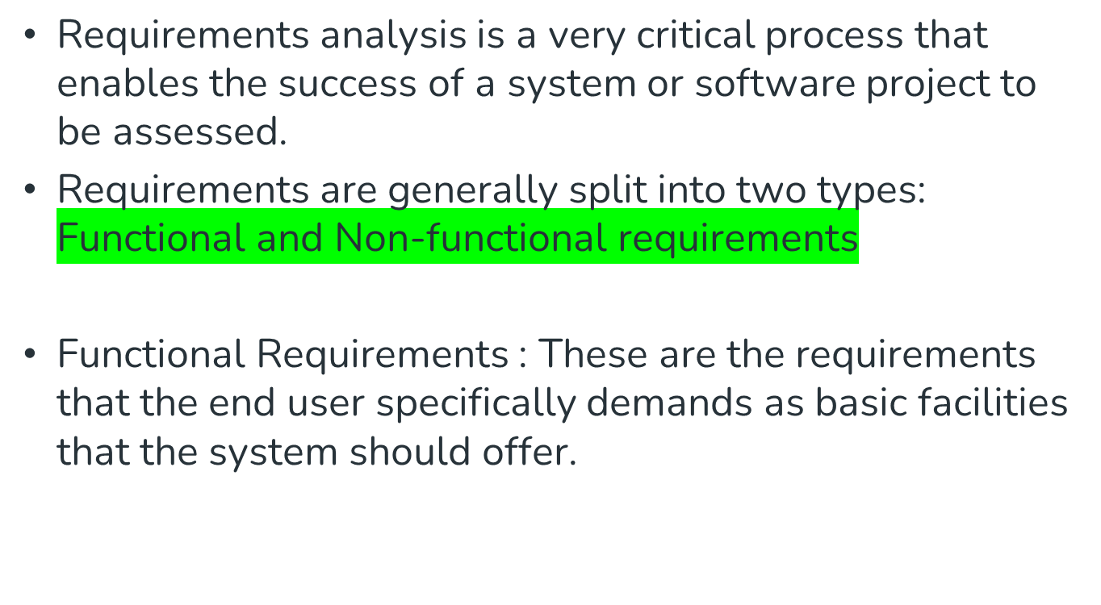
Functional and Non-Functional Requirements

Slide 7
Contd..
Functional requirements, along with requirement analysis help identify missing requirements
These are represented or stated in the form of input to be given to the system, the operation performed and the output expected.
They are the requirements stated by the user which one can see directly in the final product

Slide 8
Contd..
Non-Functional Requirements
These are the quality constraints that the system must satisfy according to the project contract.
The priority or extent to which these factors are implemented varies from one project to another

Slide 9
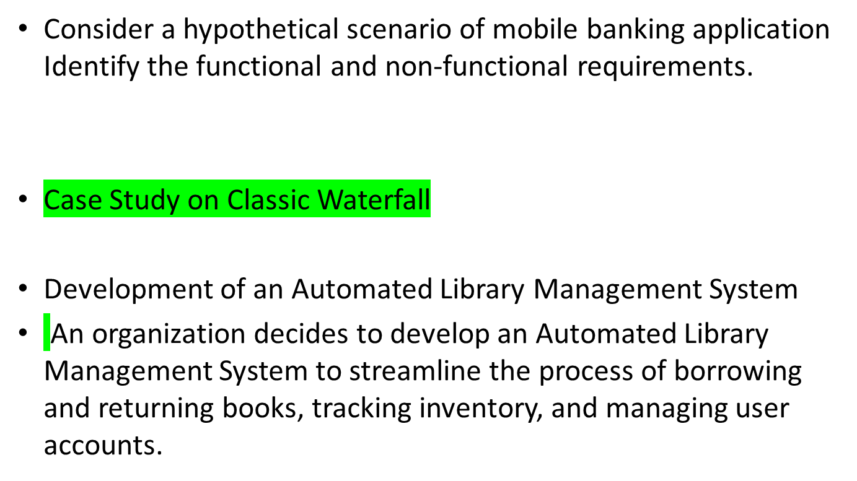
Activity

Slide 10
Contd..
Case Study on Iterative Waterfall Model
E-commerce Platform
Mention the iterations for above mentioned case study in detail.

Slide 11
Requirements Analysis and Specification
Aim of this phase:
  understand the exact requirements of the customer,
  document them properly.
Consists of two distinct activities:
  requirements gathering and analysis
  requirements specification.

Slide 12
Goals of Requirements Analysis
Collect all related data from the customer:
  analyze the collected data to clearly understand what the customer wants,
  find out any inconsistencies and incompleteness in the requirements,
  resolve all inconsistencies and incompleteness.

Slide 13
Requirements Gathering
Gathering relevant data:
  usually collected from the end-users through interviews and discussions.
  For example, for a business accounting software:
    interview all the accountants of the organization to find out their requirements.

Slide 14
Requirements Analysis (CONT.)
The data you initially collect from the users:
  would usually contain several contradictions and ambiguities:
  each user typically has only a partial and incomplete view of the system.

Slide 15
Requirements Analysis (CONT.)
Ambiguities and contradictions:
  must be identified
  resolved by discussions with the customers.
Next, requirements are organized:
  into a Software Requirements Specification (SRS) document.

Slide 16
Requirements Analysis (CONT.)
Engineers doing requirements analysis and specification:
  are designated as analysts.

Slide 17
Design
Design phase transforms requirements specification:
  into a form suitable for implementation in some programming language.

Slide 18
Design
In technical terms:
  during design phase, software architecture is derived from the SRS document.
Two design approaches:
  traditional approach,
  object oriented approach.

Slide 19
Traditional Design Approach
Consists of two activities:
  Structured analysis
  Structured design

Slide 20
Structured Analysis Activity
Identify all the functions to be performed.
Identify data flow among the functions.
Decompose each function recursively into sub-functions.
  Identify data flow among the subfunctions as well.

Slide 21
Structured Analysis (CONT.)
Carried out using Data flow diagrams (DFDs).
After structured analysis, carry out structured design:
  architectural design (or high-level design)
  detailed design (or low-level design).

Slide 22
Structured Design
High-level design:
  decompose the system into modules,
  represent relationships among the modules.
Detailed design:
  different modules designed in greater detail:
    data structures and algorithms for each module are designed.

Slide 23
Object Oriented Design
First identify various objects (real world entities) occurring in the problem:
  identify the relationships among the objects.
  For example, the objects in a pay-roll software may be:
    employees,
    managers,
    pay-roll register,
    Departments, etc.

Slide 24
Object Oriented Design (CONT.)
Object structure
  further refined to obtain the detailed design.
OOD has several advantages:
  lower development effort,
  lower development time,
  better maintainability.

Slide 25
Implementation
Purpose of implementation phase (coding phase):
  translate software design into source code.

Slide 26
Implementation
During the implementation phase:
  each module of the design is coded,
  each module is unit tested
    tested independently as a stand alone unit, and debugged,
  each module is documented.

Slide 27
Implementation (CONT.)
The purpose of unit testing:
  test if individual modules work correctly.
The end product of implementation phase:
  a set of program modules that have been tested individually.

Slide 28
Integration and System Testing
Different modules are integrated in a planned manner:
  modules are almost never integrated in one shot.
  Normally integration is carried out through a number of steps.
During each integration step,
  the partially integrated system is tested.

Slide 29
Integration and System Testing
M1
M2
M3
M4

Slide 30
System Testing
After all the modules have been successfully integrated and tested:
  system testing is carried out.
Goal of system testing:
  ensure that the developed system functions according to its requirements as specified in the SRS document.

Slide 31
Maintenance
Maintenance of any software product:
  requires much more effort than the effort to develop the product itself.
  development effort to maintenance effort is typically 40:60.

Slide 32
Maintenance (CONT.)
Corrective maintenance:
  Correct errors which were not discovered during the product development phases.
Perfective maintenance:
  Improve implementation of the system
  enhance functionalities of the system.
Adaptive maintenance:
  Port software to a new environment,
    e.g. to a new computer or to a new operating system.

Slide 33
Classical Waterfall Model
Classical waterfall model divides life cycle into phases:
  feasibility study,
  requirements analysis and specification,
  design,
  coding and unit testing,
  integration and system testing,
  maintenance.

Slide 34
Classical Waterfall Model
Feasibility Study
Req. Analysis
Design
Coding
Testing
Maintenance

Slide 35
Classical Waterfall Model (CONT.)
Most organizations usually define:
  entry and exit criteria for every phase.
They also prescribe specific methodologies for:
  specification,
  design,
  testing,
  project management, etc.

Slide 36
Drawbacks of classical water fall model
1. no feedback paths
2. difficult to accommodate changes
3. No overlapping of phases
4. Limited customer interactions

Slide 37
Iterative Waterfall Model
Classical waterfall model is idealistic:
  assumes that no defect is introduced during any development activity.
  in practice:
    defects do get introduced in almost every phase of the life cycle.

Slide 38
Iterative Waterfall Model (CONT.)
Defects usually get detected much later in the life cycle:
  For example, a design defect might go unnoticed till the coding or testing phase.

Slide 39
Iterative Waterfall Model (CONT.)
Once a defect is detected:
  we need to go back to the phase where it was introduced
  redo some of the work done during that and all subsequent phases.
Therefore we need feedback paths in the classical waterfall model.

Slide 40


Slide 43
Difference between Classic and Iterative Waterfall Model
Classic Waterfall Model
Rigidity and Inflexibility
Customer Involvements is less
High Risk of Late changes
No Iterations
Iterative Waterfall Model
Less Rigidity
More feedbacks from Customers.

Slide 44
Iterative Waterfall Model (CONT.)
Feasibility Study
Req. Analysis
Design
Coding
Testing
Maintenance

Slide 45
Iterative Waterfall Model (CONT.)
Errors should be detected
  in the same phase in which they are introduced.
For example:
  if a design problem is detected in the design phase itself,
    the problem can be taken care of much more easily than, if it is identified at the end of the integration and system testing phase.

Slide 46
Phase containment of errors
The principle of detecting errors as close to its point of introduction as possible:
  is known as phase containment of errors.
Iterative waterfall model is most widely used model.
  Almost every other model is derived from the waterfall model.

Slide 47
Prototyping Model
Before starting actual development,
  a working prototype of the system should first be built.
A prototype is a toy implementation of a system:
  limited functional capabilities,
  low reliability,
  inefficient performance.

Slide 48
Prototyping Model (CONT.)
The reason for developing a prototype is:
  it is impossible to ``get it right'' the first time,
  we must plan to throw away the first product
    if we want to develop a good product.

Slide 49
Prototyping Model (CONT.)
The developed prototype is submitted to the customer for his evaluation:
  Based on the user feedback, requirements are refined.
  This cycle continues until the user approves the prototype.
The actual system is developed using the classical waterfall approach.

Slide 50
Prototyping Model (CONT.)
Build Prototype
Customer satisfied
Requirements
Gathering
Quick Design
Customer
Evaluation of
Prototype
Design
Implement
Refine Requirements
Test
Maintenance

Slide 51
Prototyping Model (CONT.)
Even though construction of a working prototype model involves additional cost --- overall development cost might be lower for:
  systems with unclear user requirements,

Slide 52
Evolutionary Model
Evolutionary model:
  The system is broken down into several modules which can be incrementally implemented and delivered.
First develop the core modules of the system.
The initial product skeleton is refined into increasing levels of capability:
  by adding new functionalities in successive versions.

Slide 53
Evolutionary Model
The concept of the evolutionary model in software engineering came into picture when the users wanted to experience the partially developed system rather than waiting for the fully developed version
Thus, the evolutionary model is based on the idea of developing the core modules, then gradually improving the software product over time using incremental and iterative techniques with appropriate feedback.

Slide 54
Evolutionary Model (CONT.)
Successive version of the product:
  functioning systems capable of performing some useful work.
  A new release may include new functionality:
    also existing functionality in the current release might have been enhanced.

Slide 55
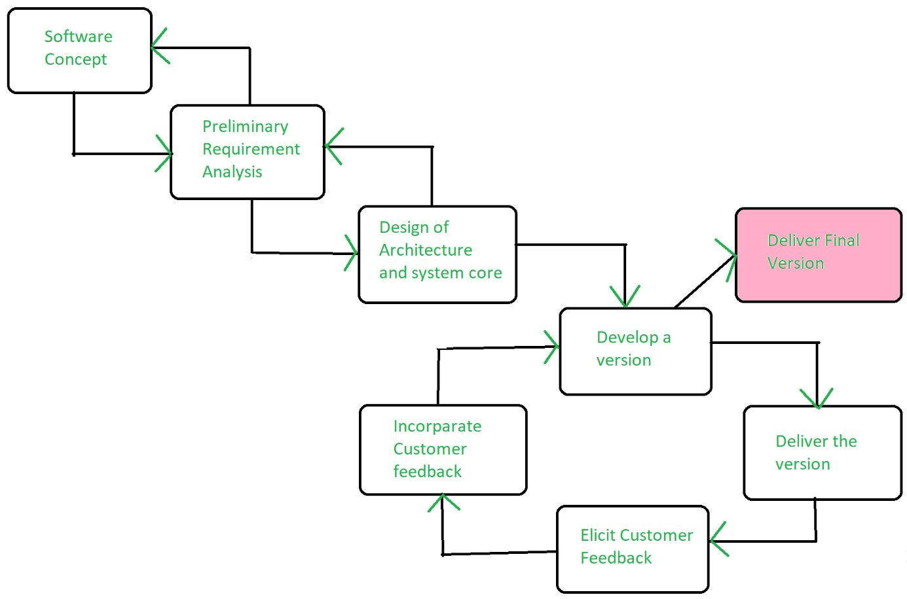
Evolutionary Model (CONT.)

Slide 56
Evolutionary Model (CONT.)
C
A
A
A
B
B

Slide 57
Advantages of Evolutionary Model
Users get a chance to experiment with a partially developed system:
  much before the full working version is released,
Helps finding exact user requirements:
  much before fully working system is developed.
Core modules get tested thoroughly:
  reduces chances of errors in final product.

Slide 58
Disadvantages of Evolutionary Model
Often, difficult to subdivide problems into functional units:
  which can be incrementally implemented and delivered.
  evolutionary model is useful for very large problems,
    where it is easier to find modules for incremental implementation.

Slide 59
Spiral Model
Proposed by Boehm in 1988.
Each loop of the spiral represents a phase of the software process:
  the innermost loop might be concerned with system feasibility,
  the next loop with system requirements definition,
  the next one with system design, and so on.
There are no fixed phases in this model, the phases shown in the figure are just examples.

Slide 60
Spiral Model (CONT.)
The team must decide:
  how to structure the project into phases.
Start work using some generic model:
  add extra phases
    for specific projects or when problems are identified during a project.
Each loop in the spiral is split into four sectors (quadrants).

Slide 61
Spiral Model (CONT.)
Determine Objectives
Identify & Resolve Risks
Review and plan for next phase
Develop Next Level of Product

Slide 62
Objective Setting (First Quadrant)
Identify objectives of the phase,
Examine the risks associated with these objectives.
  Risk:
    any adverse circumstance that might hamper successful completion of a software project.
Find alternate solutions possible.

Slide 63
Risk Assessment and Reduction (Second Quadrant)
For each identified project risk,
  a detailed analysis is carried out.
Steps are taken to reduce the risk.
For example, if there is a risk that the requirements are inappropriate:
  a prototype system may be developed.

Slide 64
Spiral Model (CONT.)
Development and Validation (Third quadrant):
  develop and validate the next level of the product.
Review and Planning (Fourth quadrant):
  review the results achieved so far with the customer and plan the next iteration around the spiral.
With each iteration around the spiral:
  progressively more complete version of the software gets built.

Slide 65
Spiral Model as a meta model
Subsumes all discussed models:
  a single loop spiral represents waterfall model.
  uses an evolutionary approach --
    iterations through the spiral are evolutionary levels.
  enables understanding and reacting to risks during each iteration along the spiral.
  uses:
    prototyping as a risk reduction mechanism
    retains the step-wise approach of the waterfall model.

Slide 66
Advantage of Spiral Model
Risk Handling: The projects with many unknown risks that occur as the development proceeds, in that case, Spiral Model is the best development model to follow due to the risk analysis and risk handling at every phase.
Good for large projects: It is recommended to use the Spiral Model in large and complex projects.
One real-life example of the Spiral Model in action is its application in the development of the Boeing 787 Dreamliner aircraft.

Slide 67
Comparison of Different Life Cycle Models
Iterative waterfall model
  most widely used model.
  But, suitable only for well-understood problems.
Prototype model is suitable for projects not well understood:
  user requirements

Slide 68
Comparison of Different Life Cycle Models (CONT.)
Evolutionary model is suitable for large problems:
  can be decomposed into a set of modules that can be incrementally implemented,
  incremental delivery of the system is acceptable to the customer.
The spiral model:
  suitable for development of technically challenging software products that are subject to several kinds of risks.

